Slide 1
ES programming + Intro to MPLAB IDE
Lecture3

Slide 2
Embedded programming

Slide 3
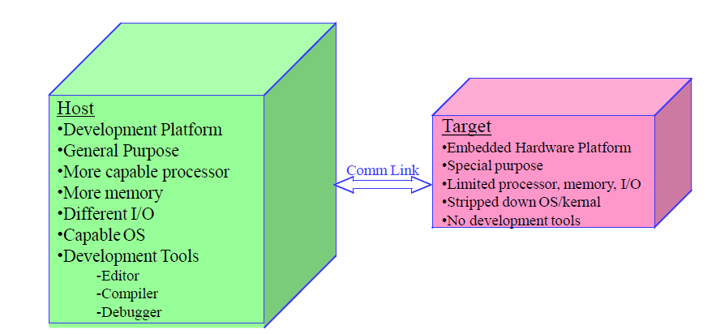
Embedded Software Development Process
Software Development is performed on a Host computer
–Compiler, Assembler, Linker, Locator, Debugger
–Produces executable binary image that will run on Target Embedded System

Slide 4
Programming Embedded Systems
Target hardware platform is different from development platform.
Development platform, called the Host Computer, is typically a general-purpose computer
Host computer runs compiler, assembler, linker, locator to create a binary image that will run on the Target embedded system
Target hardware platform contains only what is needed for final deployment
Target hardware platform does not contain development tools (editor, compiler, debugger)

Slide 5
Process for Developing Embedded Software
To develop software for a General-Purpose Computer
To develop software for an embedded system
Create source file (on Host), type in C/Assemby code (on Host)
Compile/Assemble: translate into machine code (on Host)
Link: combine all object files and libraries, resolve all symbols (on Host)
Locate: assign memory addresses to code and data (on Host)
Download: copy executable image into Target processor memory
Execute: reset Target processor
Create source file
Type in HL PL
Build: compile and link
Execute: load and run

Slide 6
Compiling Embedded Systems
Compiler translates program written in human-readable language into machine language
Source Code ==> 0bjectfile
0bject file is binary file that contains set of machine-language instructions (opcodes) and data resulting from language translation process
•Machine-language instructions are specific to a particular processor
Can the host computer's compiler be used to compile a program to run on the target computer?
A Native-compiler runs on a computer platform and produces code for that same computer platform
A Cross-compiler runs on one computer platform and produces code for another computer platform

Slide 7
Linking Embedded Systems
The Linker combines object files (from compiler) and resolves variable and function references Source code may be contained in one file, which must be combined
Resolve variables which may be referenced in one file and defined in another file
Resolve calls to library functions, like sqrt
May include operating system
Linker creates a "relocatable" version of the program
Program is complete, except no memory addresses assigned

Slide 8
Locating Embedded Systems
A Locator is the tool that performs the conversion from relocatable program to executable binary image
The Locator assigns physical memory addresses to code and data sections within the relocatable program
The Locator produces a binary memory image that can be loaded into the target R0M
In contrast, on General Purpose Computers, the operating system assigns the addresses at load time

Slide 9
Downloading and Executing Your Program
0nce a program has been successfully compiled, linked, and located, it must be moved to the target platform
Download the binary image to the embedded system. Executable binary image is transferred and loaded into a memory device on target board Can be loaded into R0M via a device programmer, which "burns" a chip that is then re-inserted into the embedded system
Your program will then execute when you reset the processor, or apply power to the embedded system

Slide 10
Review Process for Developing Embedded Software
To develop software for an embedded system
Create source file (onHost)
Type in C/assembely code (onHost)
Compile/Assemble: translate into machine code (on Host)
Link: combine all object files and libraries, resolve all symbols (on Host)
Locate: assign memory addresses to code and data (on Host)
Download: copy executable image into Target processor memory
Execute: reset Target processor

Slide 11
Debugging Embedded Software
Now that the software has been downloaded to the target processor, how do we know if it is working?
Run-time errors are not as obvious
Most embedded systems do not have a "screen"
When a program fails, usually causes the processor to crash or lock-up
Logic errors
If program runs, is it performing the correct steps?

Slide 12
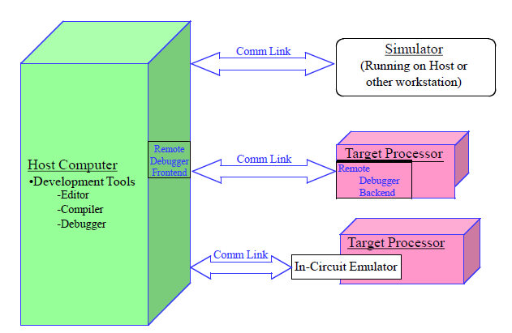
Debugging Tools

Slide 13
Debugging with Simulators
Simulator is host-based program that simulates functionality and instruction set of target processor
Front-end has text or GUI-based windows for source code, register contents, etc
Valuable during early stages of development
Disadvantage: only simulates processor, not peripherals

Slide 14
Debugging with Remote Debuggers
Remote Debuggers used to monitor/control embedded SW
Used to download, execute and debug embedded software over communications link (e.g., serial port)
Front-end has text or GUI-based windows for source code, register contents, etc
Backend provides low-level control of target processor, runs on target processor and communicates to front-end over comm-link

Slide 15
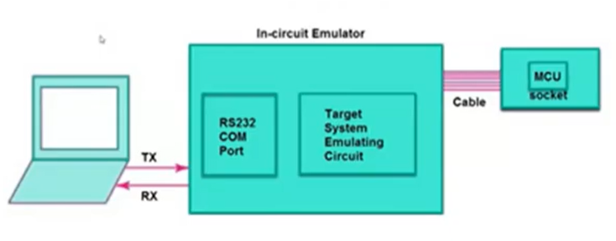
Debugging with In-Circuit Emulators
Take the place of (i.e., emulates) target processor
Contains copy of target processor, plus RAM, R0M, and its own embedded software
Allows you to examine state of processor while program is running
Stores information about each processor cycle that is executed
Allows you to see what order things happened
Disadvantage: Expensive

Slide 16
Reference
https://www.oreilly.com/library/view/programming-embedded-systems/0596009836/ch04.html

Slide 17
Introduction to MPLAB IDE + Proteus

